Slide 1
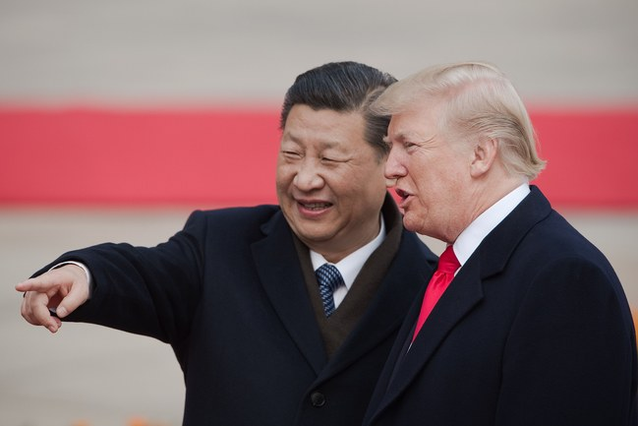
Is China Winning the Trade War ?
https://www.newyorker.com/news/our-columnists/why-china-is-winning-the-trade-war

Slide 2
Is China Winning the Trade War ?
https://www.newyorker.com/news/our-columnists/why-china-is-winning-the-trade-war

Slide 3
Distributed Representation of Chinese Collocation
Bo Xia and Endong Xun

Slide 4
Introduction
What is collocation?
Why collocation is meaningful for us?
How to represent a collocation?

Slide 5
What is collocation?
Introduction
MWEs definition
lexical chunks definition
My definition of collocation
Notes:
Collocation examples from compulsory English lesson, trade war

Slide 6

Notes:
Collocation examples from compulsory English lesson

Slide 7
decrease to
die out
in peace
burst into laughter
appreciate doing sth
before long
for sure
in relief
according to
have an effect on
decrease
loss
in danger of
protect A from B
long before
come into being
so that
pat attention to
in such a short time
succeed in doing sth
Notes:
Collocation examples from compulsory English lesson

Slide 8
What is collocation?
Introduction
Idiom
MWEs
Lexical chunks
Notes:
Collocation examples from compulsory English lesson, trade war

Slide 9
What is collocation?
Introduction
My definition of collocation
Notes:
Collocation examples from compulsory English lesson, trade war

Slide 10
Why collocation is meaningful for us?
Introduction
Important role of language phenomenon in syntactic and semantic,
But need to use it well.
Generate period
Recognition period

Slide 11
How to represent a collection?
Introduction
List
Table: ex. Encoding MWEs in a conceptual lexicon
Triple
Feature-based description, rules or labels
Notes:
截图对应的描述方法

Slide 12
Basic Notions

Slide 13

Basic Notions

Slide 14
Model Architecture

Slide 15
The objective of Collocation prediction
Model Architecture

Slide 16
Continuous Skip-gram Model
Model Architecture

Slide 17
A combination of ontology and hierarchical softmax
Model Architecture

Slide 18
Experiment

Slide 19
Experimental setup
Experiment

Slide 20
Neighbors of one collocation
Experiment

Slide 21
Measuring collocation intensity
Experiment

Slide 22
Verb-verb phrase recognition
Experiment

Slide 23
Conclusion and future work

Slide 24
Distributed Representation of Chinese Collocation
Bo Xia and Endong Xun
Beijing language and culture university
https://github.com/xiabo0816/Chinese_MWEs_Representation

Slide 25
Distributed Representation of Chinese Collocation
Bo Xia and Endong Xun Beijing language and culture university

